Slide 1
Martial Arts Gym Tracking and Information System
T29 - TeamBits
Aldrin Jacildo
Sir Angel Naguit
Francis Victa
Maria Lilian Yang

Slide 2
Main Roles
Aldrin John Jacildo | Admin User Modules, Email Feature Implementation
Sir Angel Naguit | Member User Modules, User Authentication
Francis Victa | Backend API, Database Admin
Maria Lilian Yang | Instructor User Modules, QR Scan Implementation

Slide 3
APPLICATION DEMO

Slide 4
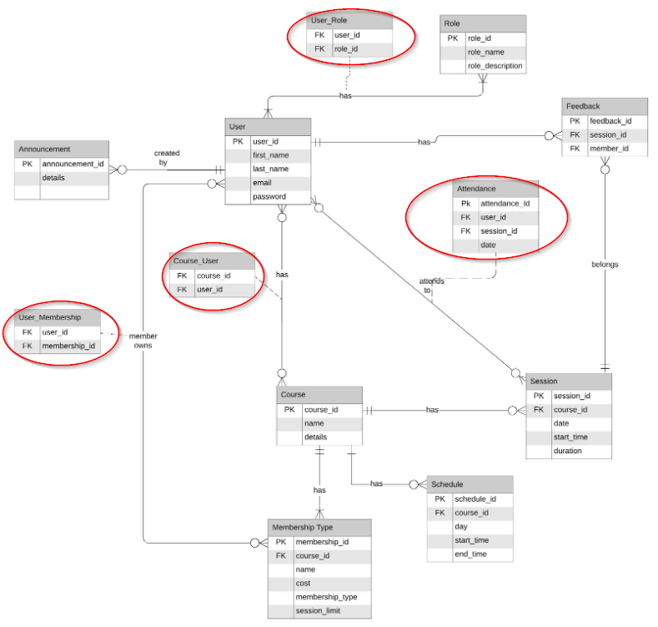
Initial DB Design
Designed using SQL principles
Linking tables do not apply to NoSQL databases
Redesigned to fit NoSQL DB using subdocuments

Slide 5
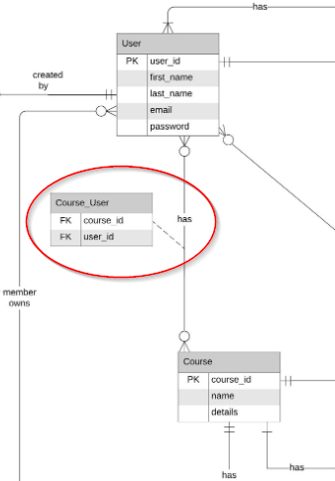
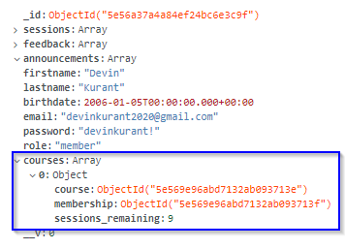
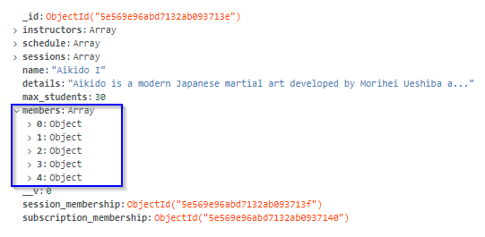
User
Course

Slide 6
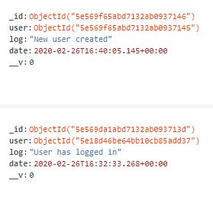
Current DB Design
Reduced number of tables from 12 to only 8 collections
Announcements
Courses
Feedback
Logs*
Memberships
Schedule
Sessions
Users
*recent addition

Slide 7







Technologies Used
Development Stack: MongoDB ExpressJS Angular 8 NodeJS
Deployment Pipeline:
Web Host: Heroku Database Server: MongoDB Atlas Version Control: GitHub

Slide 8

NPM Modules and Other Libraries
Angular Material | CSS Design library built for Angular
Nodemailer | E-mail sender to send information to users
jsonwebtoken | Create JSON Web Tokens (JWT) to identify user and roles (grants level of access to application)
jwt-decode | Decode JSON Web Tokens
ngx-qrcode2 | Generate QR code from User ID
zxing/ngx-scanner | QR Code scanner to scan User IDs for check-in
mongoose | ODM Library for MongoDB
mongoose-autopopulate | Auto-populates subdocuments; Make mongoose querying a little bit easier

Slide 9

Milestones
Phase 1 | Login/Logout Module Member Account Manager Backend Course Enrollment for Members Feature Backend Member Module Backend Instructor Account Manager Instructor Module Backend | 17 January 2020
Phase 2 | Member Account Management Frontend Course Enrollment for Members Frontend Member Module Frontend Course Manager Backend and Frontend Membership Type Manager Instructor Module Frontend | 31 January 2020
Phase 3 | Session Module QR Generator and Scanning Module | 21 February 2020

Slide 10

Milestones
Phase 4 | Announcement Manager Email Feature Session Feedback Feature | 6 March 2020
Final Phase | Integration of Email Integration of Check-in Integration of Session Feedback Integration of Event Log Fix Bugs User Testing Deployment (completed) Presentation | 20 March 2020
Status: On Track!

Slide 11

Risks
Risk | Risk Ranking | RIsk Impact | Mitigation Strategy | Status
Incorrect time estimation for task completion which could delay production | Med | High | Adjust due dates and tasks accordingly. Project leader needs to be strict with due dates. | SAFE
MongoDB service outage | Low | High | Installing local MongoDB to test locally will help mitigate risk. | SAFE
Exams and other projects may delay completion of final tasks | Low | High | The group needs to finish tasks earlier and avoid delays. Time Management | ONGOING

Slide 12





Conclusion
Project completion is right around the corner!
Focus on final integration of remaining features and fixing bugs
More user testing to come
NPM is very powerful!
Importance of teamwork and communication
Lily-chan is a strict but great team lead! 😸
Get well soon miss Anjana!

